Slide 1
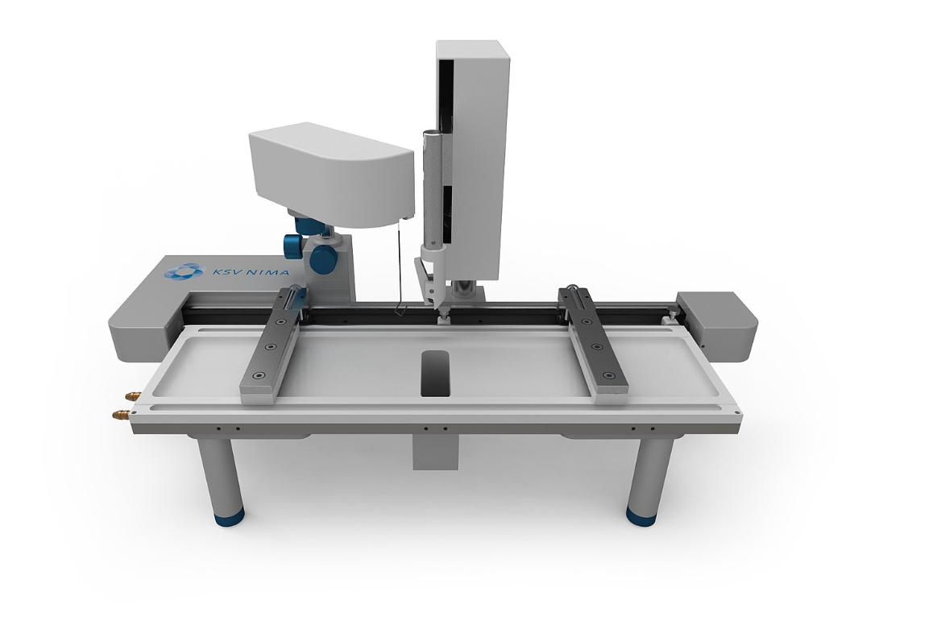
How To… Langmuir Trough
YeJun Park
MIA

Slide 2
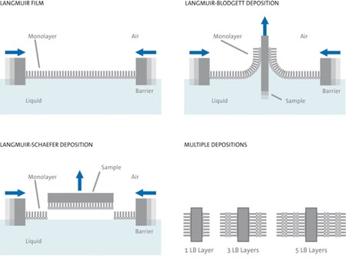
What is Langmuir Trough?
Langmuir, Langmuir-Blodgett (LB) or Langmuir-Schaefer monolayer or film.
It allows you to mimick confined 2D study of your interested monolayer.
Monolayers can be made with
Lipids
Nanoparticles

Slide 3
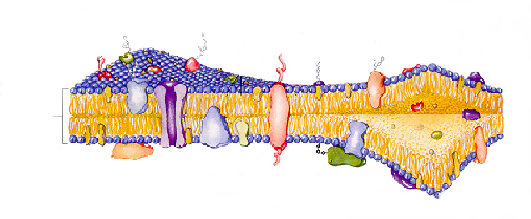
What is a Model Cell Membrane?
proteins
lipids
cholesterol
Lipid
bilayer
hydrophilic head
“water loving”
hydrophobic tail
“water hating”
Dipalmitoylphosphatidylcholine (DPPC)
Lehninger; Nelson; Cox; Principles of Biochemistry, 1993.
Notes:
Cellular membrane complex - protective barrier to the cell, regulates flow into and out of the cell; each lipid has different tg and there is an assymmetry of lipids in each leaflet
100s of different lipids. Lipids usually referred to by the headgroup so this is a PC lipid in particular DPPC due to the tailgroups. The headgroup deterines the size and the interactions so that is what we are interested in detecting with our techniques

Slide 4
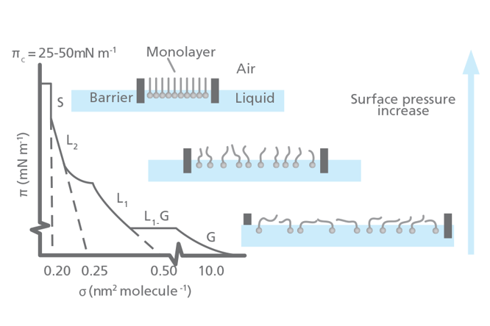
What does langmuir monolayer tell you?
inference and understanding about how particular molecules can be packed in confined 2D
The prove measures the surface tension which allows us to get an idea of the surface pressure.
pressure-area isotherm can also provide a measure of the average area per molecule and the compressibility of the monolayer.

Slide 5
How do you use Model Cell Membranes to investigate results of molecular interactions?
Cell Membrane
added
molecule
less area per molecule
More Ordered
+
more area per molecule
Less Ordered - FLUID
Notes:
Say disordered, LOOK FOR ARTICLE on DETERGENT RESISTENT FRACTIONS!! 1980s Detergent resistent membranes DRMs When the non-ionic detergent is added to cells, the fluid membrane will associate into solution while the lipid rafts will remain intact and can be extracted. Due to tight packing of lipid chains

Slide 6
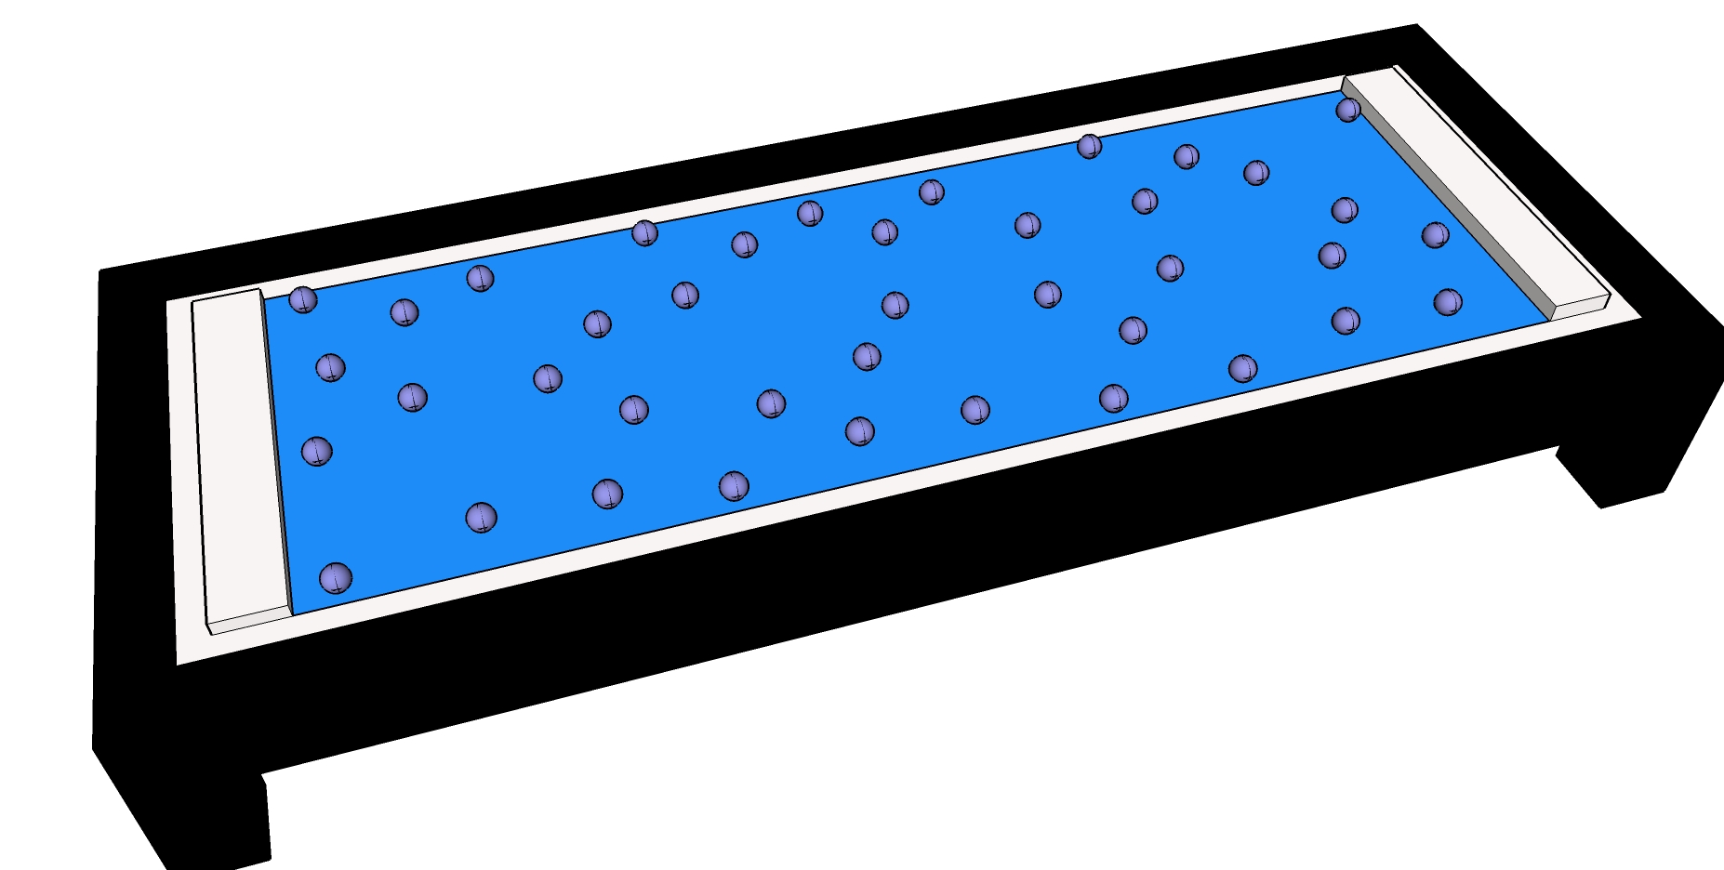
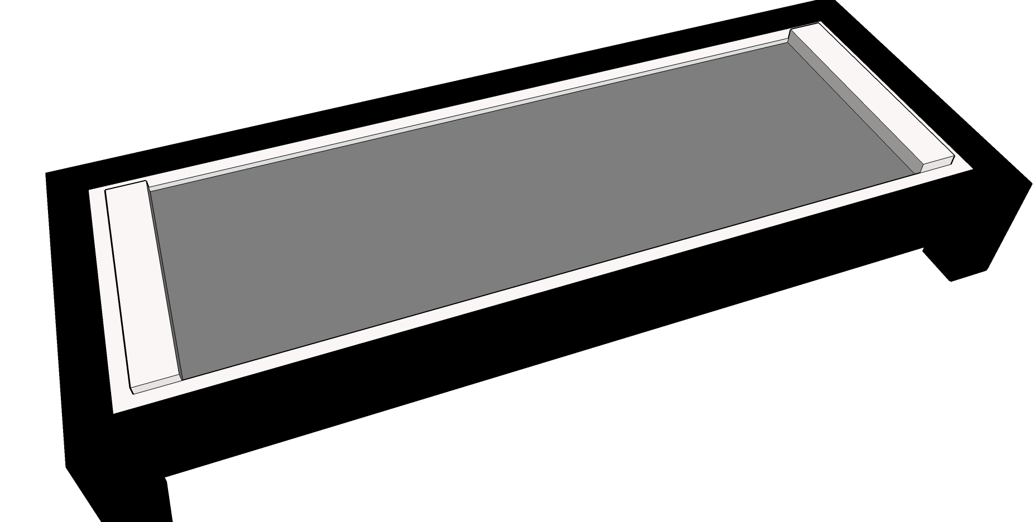
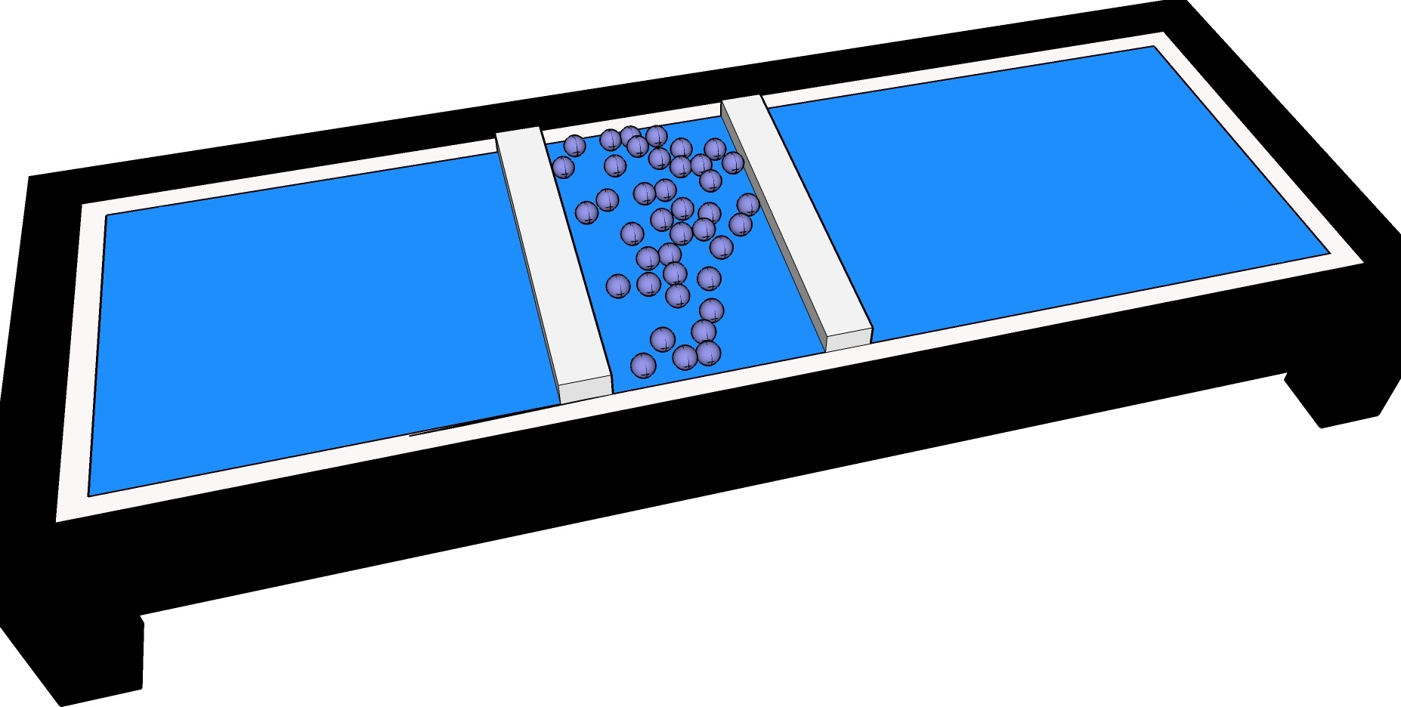
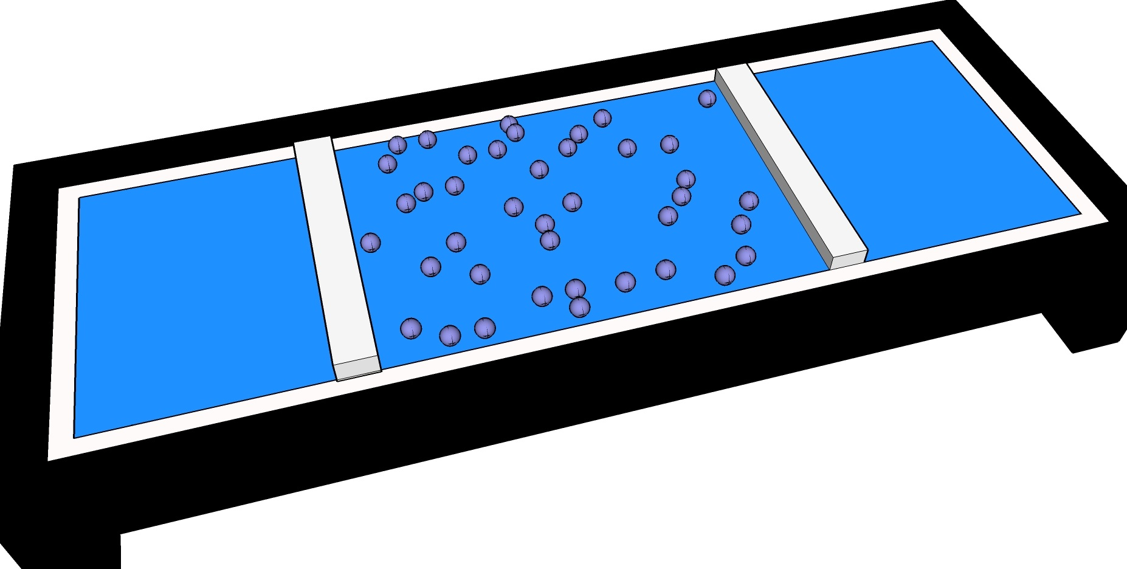
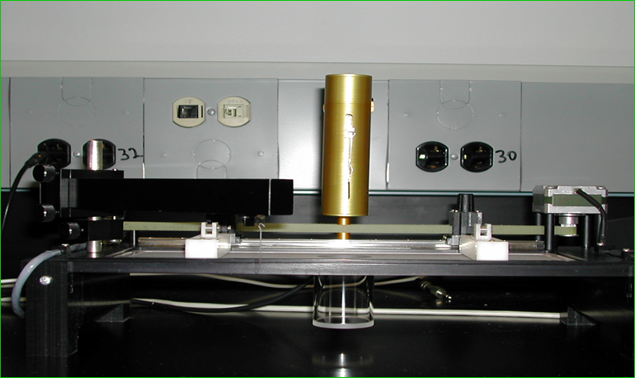
Instrument
Langmuir Trough
Probe
Barriers
Notes:
Explain subphase

Slide 7
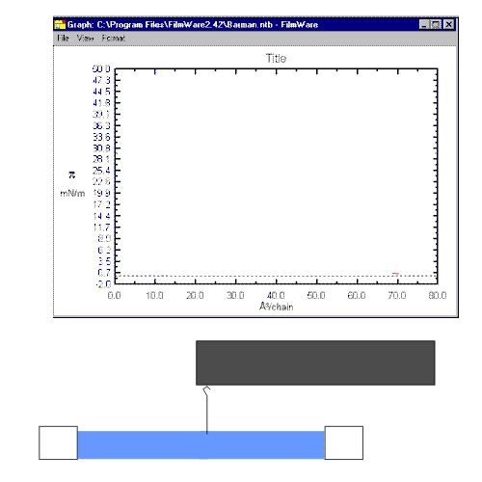
“In Real Time”
π = γ_{water} – γ_{water+lipid}
Notes:
Just like we can look at interactions among moleules of the same lipid, we can look at interactions among DIFFERENT lipid molecles

Slide 9
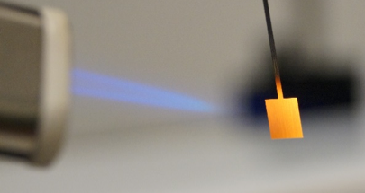
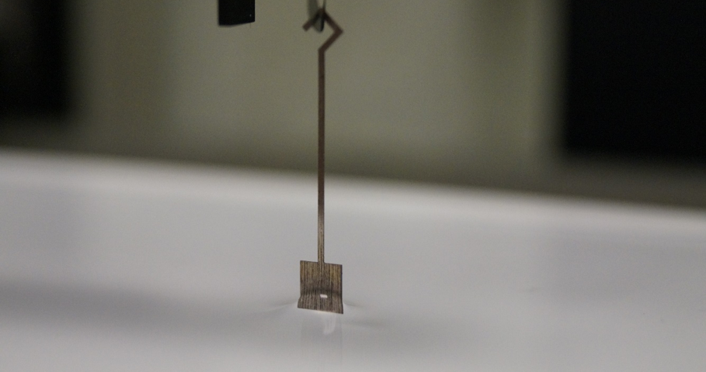
Prep Step
Using lighter or mini torch

Slide 10
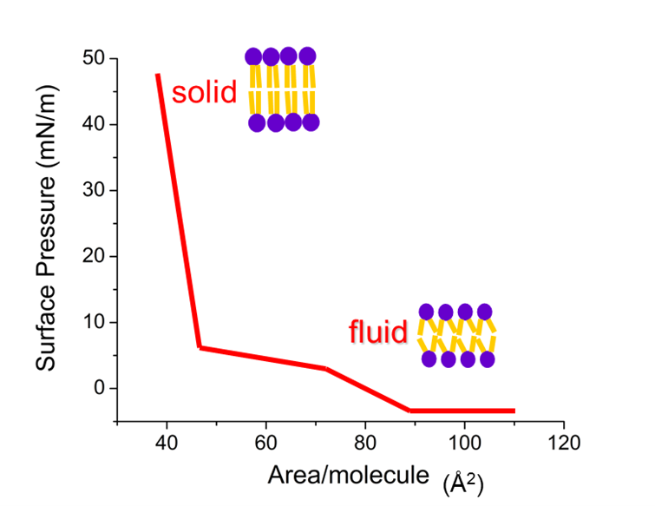
Limiting area
The tightest a lipid can pack giving the minimum area.
Determining limiting area is a way of testing fluidity of a model membrane
Steepest Slope
Limiting molecular area
Limiting molecular area

Slide 11
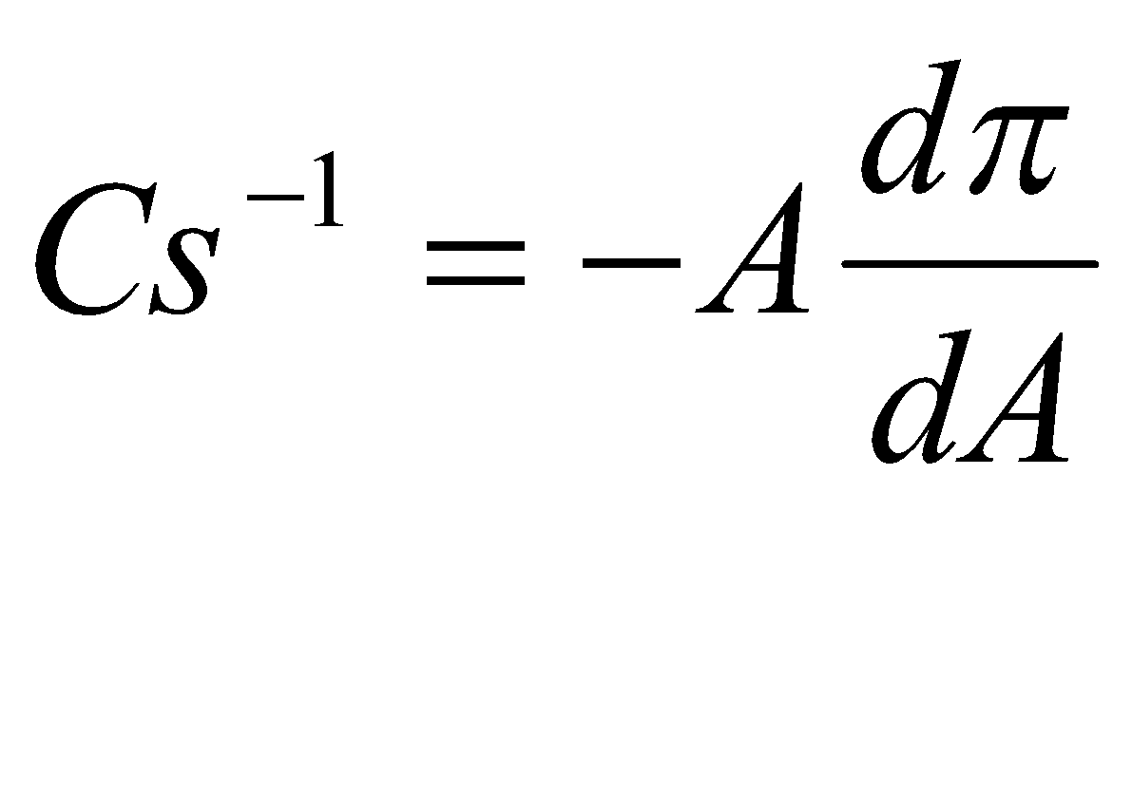
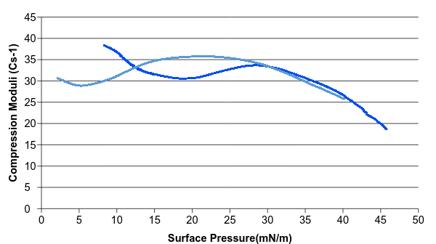
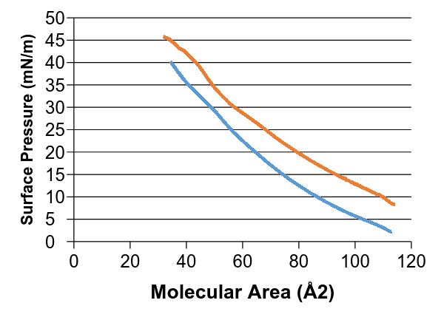
Interpreting the Extent of Interaction Compression Modulus
E.Coli + hop acid
E.coli
E.Coli + hop acid
E.coli
The higher the compression modulus; the more condensed the system is considered to be due to strong molecular interactions
Notes:
Insert a chart shows the comp. modulus value for graph shown above

Slide 12
Thanks
My Undergraduate PI Dr. Goach, Audra from Monmouth College.
To all of you listening my talk today.

